Slide 1
Introduction to Computer Programming Lecture 6.1:
Reading and Writing Files, User Input
Hemma Philamore
Department of Engineering Mathematics

Slide 2
Introduction to Computer Programming Lecture 6.1.a:
Reading and Writing Files
Hemma Philamore
Department of Engineering Mathematics

Slide 3
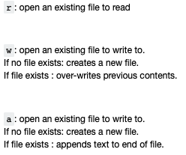
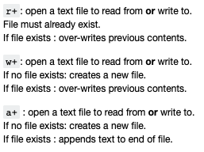
Reading/Writing files
Functions for reading and writing to external files:
open, read, write, close
Data structures can be populated based on data in another format (text file, database, etc.)
open(file_path, mode_specifier)

Slide 4
Why do we need to close a file?
Not automatically closed.
Risk of overwriting.
Saves changes to file.
Depending on OS, you may not be able to open a file simultaneously for reading and writing.
Example: If a program attempts to open a file that is already open (has not been closed), an error may be generated.

Slide 5

HighScore Table
The table should be saved to a file
1
John Mayer
550
2
Mary Loe
480
3
Tony Times
380
4
Kent Clear
305
5
Sara Knight
150

Slide 6
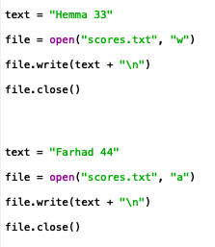

Writing Files
Mode specifier to write
Mode specifier to append
Open the file using a text editor to confirm it's contents.

Slide 7
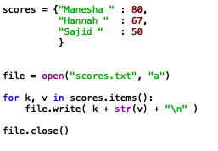
Writing Files
Dictionary
Open file before for loop
Close file after for loop
Use for loop to write dictionary to text file
Open the file using a text editor to confirm it's contents.

Slide 8
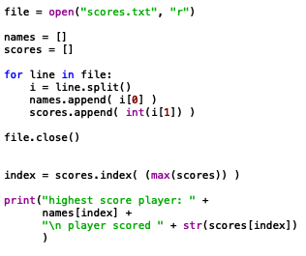
Reading Files
Open with mode specifier “r”
Open returns an iterable object.
Use for loop to iterate
Remember to close the file!

Slide 9
Reading Files
Split divides the line: items separated by spaces, into string items of list. Alternative delimiter can be selected
Each line is a string
Finding the highest scoring player

Slide 10
Reading Files
File is an iterable object
Each item (line) is a string

Slide 11
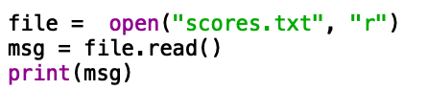
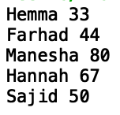
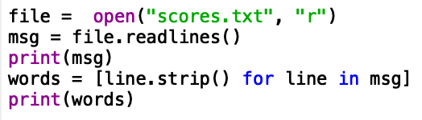
Reading Files
File contents as a single string
File contents as a list of lines as strings
Newline “/n” removed using strip()

Slide 12
Introduction to Computer Programming Lecture 6.1.b:
Automatically Closing Files, User Input
Hemma Philamore
Department of Engineering Mathematics

Slide 13


Automatically close files using with
It can be difficult to remember to close the file
with open opens the file…
…it is closed again automatically when the code unindents
Notes:
Lots of errors in with opens : redo example

Slide 14
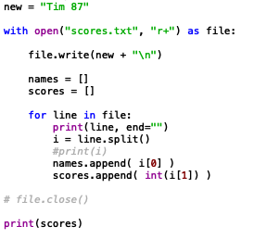
Read and write
Mode specifier allows read and write
write
read

Slide 15


open(file_path, mode_specifier)
open(“scores.txt”, w)
Documents
scores.txt
Folder_1
Folder_2
myScores.txt
scores.txt
6_1_read_write.py

Slide 16
open(file_path, mode_specifier)
open( “../Folder_1/myScores.txt”, w)
Documents
scores.txt
Folder_1
Folder_2
myScores.txt
scores.txt
6_1_read_write.py

Slide 17
open(file_path, mode_specifier)
open(“../scores.txt”, w)
Documents
scores.txt
Folder_1
Folder_2
myScores.txt
scores.txt
6_1_read_write.py

Slide 18

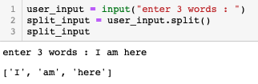
Input
Variable to store the user input
Prompt shown to the user
Delimited values returned as a list

